Slide 1
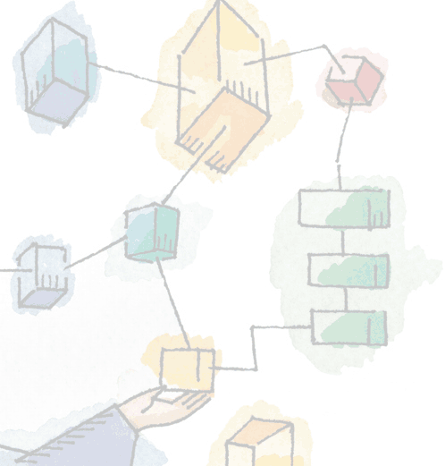
Chapter 16 Client/Server Computing
Operating Systems: Internals and Design Principles, 6/E William Stallings
Notes:
These slides are intended to help a teacher develop a presentation. This PowerPoint covers the entire chapter and includes too many slides for a single delivery. Professors are encouraged to adapt this presentation in ways which are best suited for their students and environment.

Slide 2
Roadmap
Distributed Computing Introduction
Client/Server Computing
Distributed message passing
Remote Procedure Calls
Clusters
Windows Cluster Server
Sun Cluster
Beowulf and Linux Clusters
Notes:
We begin with an introduction to the topic of Distributed Data Processing then move on to examine some of the key concepts in distributed software, including client/server architecture, message passing, and remote procedure calls.
Then we examine the increasingly important cluster architecture.

Slide 3
Traditional Data Processing
Traditionally data processing was centralised
Typically involving centralised
Computers
Processing
Data
Notes:
Traditionally, the data processing function was organized in a centralized fashion.
Data processing support is provided by one or a cluster of computers, generally large computers, located in a central data processing facility.
Many of the tasks performed by such a facility are initiated at the center with the results produced at the center.
Other tasks may require interactive access by personnel who are not physically located in the data processing center.
In a centralized architecture, each person is provided with a local terminal that is connected by a communications facility to the central data processing facility.
A fully centralized data processing facility is centralized in many senses of the word:
Centralized computers:
One or more computers are located in a central facility.
Centralized processing:
All applications are run on the central data processing facility.
This includes applications that are clearly central or organization-wide in nature, such as payroll, as well as applications that support the needs of users in a particular organizational unit.
Centralized data:
All data are stored in files and databases at the central facility and are controlled by and accessible by the central computer or computers

Slide 4
Distributed Data Processing
Distributed Data Processing (DDP) departs from the centralised model in one or multiple ways.
Usually smaller computers, are dispersed throughout an organization.
May involve central node with satellites, or be a dispersed peer to peer approach
Interconnection is usually required
Notes:
A data processing facility may depart in varying degrees from the centralized data processing organization by implementing a distributed data processing (DDP) strategy.
A distributed data processing facility is one in which computers, usually smaller computers, are dispersed throughout an organization.
The objective of such dispersion is to process information in a way that is most effective based on operational, economic, and/or geographic considerations, or all three.
A DDP facility may include a central facility plus satellite facilities, or it may more nearly resemble a community of peer computing facilities.
In either case, some form of interconnection is usually needed;
I.E. the various computers in the system must be connected to one another.

Slide 5
Advantages of DDP
Responsiveness
Availability
Resource Sharing
Incremental growth
Increased user involvement and control
End-user productivity
Notes:
The advantages of DDP include the following:
Responsiveness:
Local computing facilities can be managed in such a way that they can more directly satisfy the needs of local organizational management than one located in a central facility and intended to satisfy the needs of the total organization.
Availability:
With multiple interconnected systems, the loss of any one system should have minimal impact.
Key systems and components (e.g., computers with critical applications, printers, mass storage devices) can be replicated so that a backup system can quickly take up the load after a failure.
Resource sharing:
Expensive hardware can be shared among users.
Data files can be centrally managed and maintained, but with organization-wide access.
Staff services, programs, and databases can be developed on an organization wide basis and distributed to the dispersed facilities.
Incremental growth:
In a centralized facility, an increased workload or the need for a new set of applications usually involves a major equipment purchase or a major software upgrade. This involves significant expenditure.
In addition, a major change may require conversion or reprogramming of existing applications, with the risk of error and degraded performance.
With a distributed system, it is possible to gradually replace applications or systems, avoiding the “all-or-nothing” approach.
Also, old equipment can be left in the facility to run a single application if the cost of moving the application to a new machine is not justified.
Increased user involvement and control:
With smaller, more manageable equipment physically located close to the user, the user has greater opportunity to affect system design and operation, either by direction interaction with technical personnel or through the user’s immediate superior.
End-user productivity:
Distributed systems tend to give more rapid response time to the user, since each piece of equipment is attempting a smaller job.
Also, the applications and interfaces of the facility can be optimized to the needs of the organizational unit.
Unit managers are in a position to assess the effectiveness of the local portion of the facility and to make the appropriate changes.

Slide 6
Roadmap
Distributed Computing Introduction
Client/Server Computing
Distributed message passing
Remote Procedure Calls
Clusters
Windows Cluster Server
Sun Cluster
Beowulf and Linux Clusters

Slide 7
Client/Server Computing
Client machines are generally single-user workstations providing a user-friendly interface to the end user
Each server provides a set of shared services to the clients
enables many clients to share access to the same database
enables the use of a high-performance computer system to manage the database
Notes:
The client machines are generally single-user PCs or workstations that provide a highly user-friendly interface to the end user.
The client-based station generally presents the type of graphical interface that is most comfortable to users, including the use of windows and a mouse.
Microsoft Windows and Macintosh OS provide examples of such interfaces.
Client-based applications are tailored for ease of use and include such familiar tools as the spreadsheet.
Each server in the client/server environment provides a set of shared services to the clients.
The most common type of server currently is the database server, usually controlling a relational database.
The server enables many clients to share access to the same database and enables the use of a high-performance computer system to manage the database.

Slide 8
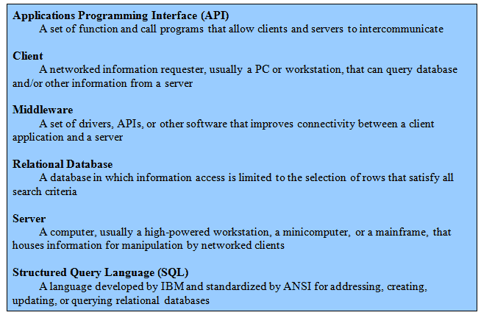
Client/Server Terminology

Slide 9
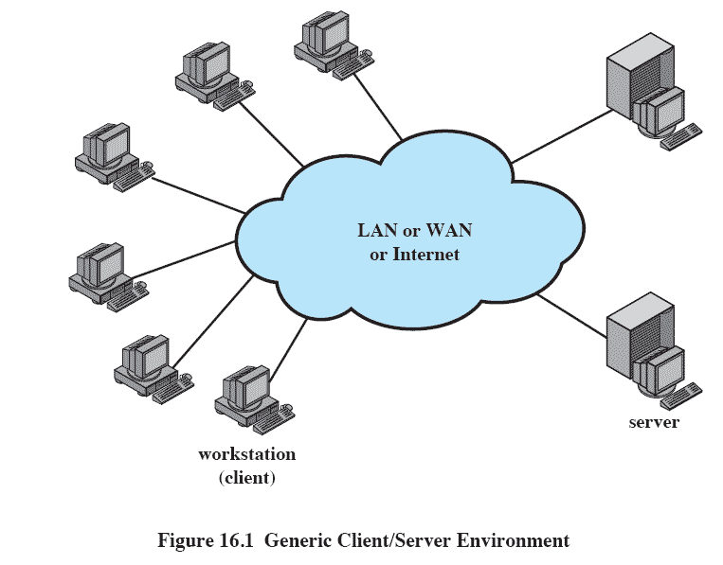
Generic Client/Server Environment
Notes:
The third essential ingredient of the client/server environment is the network.
Client/server computing is typically distributed computing.
Users, applications, and resources are distributed in response to business requirements and linked by a single LAN or WAN or by an internet of
networks.

Slide 10
Client/Server Applications
The key feature of a client/server architecture is the allocation of application-level tasks between clients and servers.
Hardware and the operating systems of client and server may differ
These lower-level differences are irrelevant as long as a client and server share the same communications protocols and support the same applications
Notes:
The key feature of a client/server architecture is the allocation of application-level tasks between clients and servers.

Slide 11
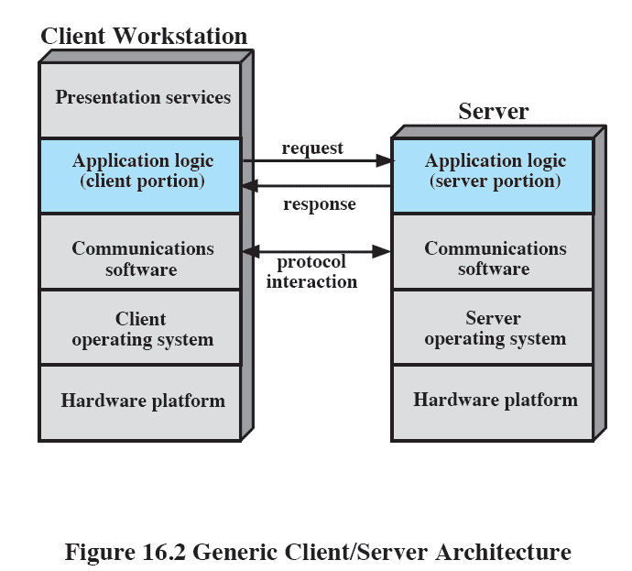
Generic Client/Server Architecture
Notes:
In both client and server, of course, the basic software is an operating system running on the hardware platform.
The platforms and the operating systems of client and server may differ.
Indeed, there may be a number of different types of client platforms and operating systems and a number of different types of server platforms in a single environment.
As long as a particular client and server share the same communications protocols and support the same applications, these lower-level differences are irrelevant.

Slide 12
Client/Server Applications
Bulk of applications software executes on the server
Application logic is located at the client
Presentation services in the client

Slide 13
Database Applications
The server is a database server
Most common family of client/server applications
Interaction is in the form of transactions
the client makes a database request and receives a database response from server
Server is responsible for maintaining the database
Notes:
In this environment, the server is essentially a database server.
Interaction between client and server is in the form of transactions in which the client makes a database request and receives a database response.

Slide 14
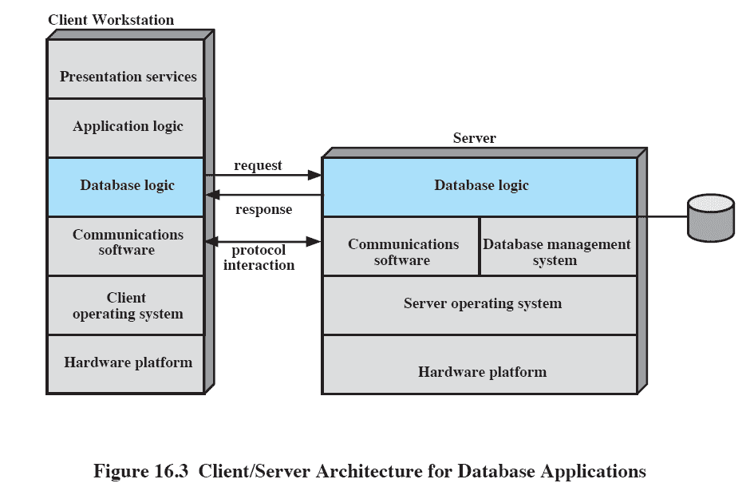
Architecture for Database Applications
Notes:
The server is responsible for maintaining the database, for which purpose a complex database management system software module is required.
A variety of different applications that make use of the database can be housed on client machines.
The “glue” that ties client and server together is software that enables the client to make requests for access to the server’s database.
This figure suggests that all of the application logic is on the client side, while the server is only concerned with managing the database.
Whether such a configuration is appropriate depends on the style and intent of the application.

Slide 15
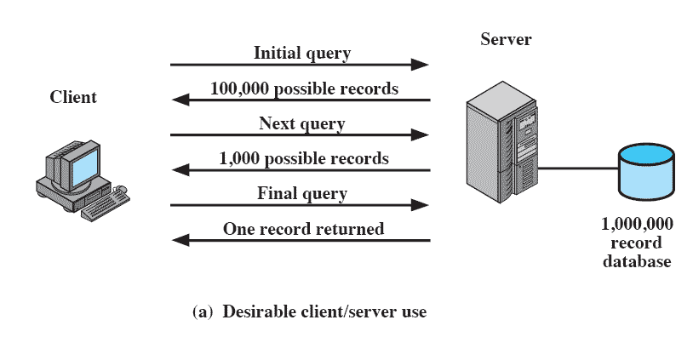
Client/Server Database Usage
Notes:
This figure shows how this might work.
Suppose that the server is maintaining a database of 1 million records, and the user wants to perform a lookup that should result in zero, one, or at most a few records.
The user could search for these records using a number of search criteria
(e.g., records older than 1992; records referring to individuals in Ohio; records referring to a specific event or characteristic, etc.).
An initial client query may yield a server response that there are 100,000 records that satisfy the search criteria.
The user then adds additional qualifiers and issues a new query.
A response indicating that there are 1000 possible records is returned.
Finally, the client issues a third request with additional qualifiers.
The resulting search criteria yield a single match, and the record is returned to the client.

Slide 16
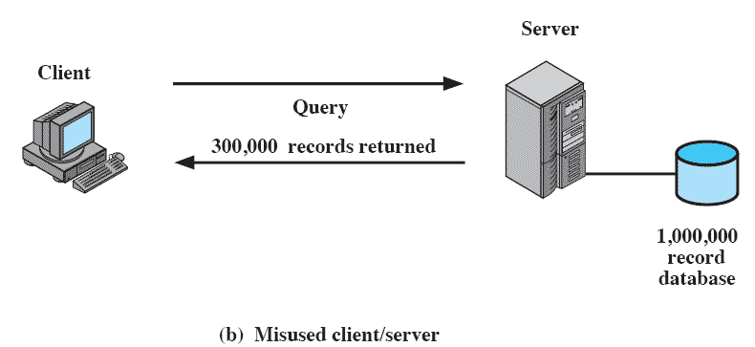
Client/Server Database Usage
Notes:
In this case, a single query results in the transmission of 300,000 records over the network.
This might happen if, for example, the user wishes to find the grand total or mean value of some field across many records or even the entire database.
One solution to this problem, is to move part of the application logic over to the server.
IE the server can be equipped with application logic for performing data analysis as well as data retrieval and data searching.

Slide 17
Classes of Client/Server Architecture
A spectrum of implementations exist.
Four general classes are:
Host-based processing
Server-based processing
Cooperative processing
Client-based processing
Notes:
Within the general framework of client/server, there is a spectrum of implementations that divide the work between client and server differently.
There are other ways of classifying client/server arrangements.

Slide 18
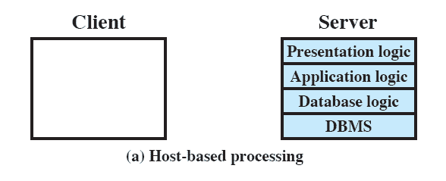
Host-based processing
Not true client/server computing
Traditional mainframe environment
all or virtually all of the processing is done on a central host.
Notes:
Host-based processing is not true client/server computing as the term is generally used.
Rather, host-based processing refers to the traditional mainframe environment in which all or virtually all of the processing is done on a central host.
Often the user interface is via a dumb terminal.
Even if the user is employing a microcomputer, the user’s station is generally limited to the role of a terminal emulator.

Slide 19
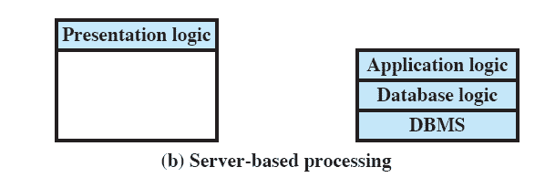
Server-based processing
Server does all the processing
Client provides a graphical user interface
Notes:
The most basic class of client/server configuration is one in which the client is principally responsible for providing a graphical user interface, while virtually all of the processing is done on the server.
This configuration is typical of early client/server efforts, especially departmental-level systems.
The rationale behind such configurations is that the user workstation is best suited to providing a user-friendly interface and that databases and applications can easily be maintained on central systems.
Although the user gains the advantage of a better interface, this type of configuration does not generally lend itself to any significant gains in productivity or to any fundamental changes in the actual business functions that the system supports.

Slide 20
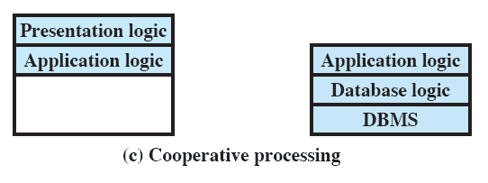
Client-based processing
All application processing done at the client
Data validation routines and other database logic functions are done at the server
Notes:
Virtually all application processing may be done at the client, with the exception of data validation routines and other database logic functions that are best performed at the server.
Generally, some of the more sophisticated database logic functions are housed on the client side.
This architecture is perhaps the most common client/server approach in current use.
It enables the user to employ applications tailored to local needs.

Slide 21
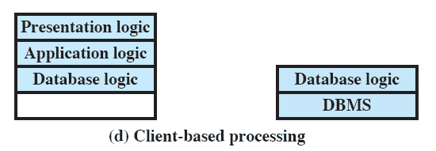
Cooperative processing
Application processing is performed in an optimized fashion
Complex to set up and maintain
Offers greater productivity and efficiency
Notes:
The application processing is performed in an optimized fashion, taking advantage of the strengths of both client and server machines and of the distribution of data.
Such a configuration is more complex to set up and maintain but, in the long run, this type of configuration may offer greater user productivity gains and greater network efficiency than other client/server approaches.

Slide 22
Three-tier Client/Server Architecture
Application software distributed among three types of machines
User machine
Thin client
Middle-tier server
Gateway
Convert protocols
Merge/integrate results from different data sources
Backend server
Notes:
The traditional client/server architecture involves two levels, or tiers:
a client tier and
a server tier.
A three-tier architecture is also common.
The application software is distributed among three types of machines:
a user machine,
a middle-tier server, and
a backend server.
The middle-tier machines are essentially gateways between the thin user clients and a variety of backend database servers.
The middle-tier machines can convert protocols and map from one type of database query to another.
Also, the middle-tier machine can merge/integrate results from different data sources.
The middle-tier machine can serve as a gateway between the desktop applications and the backend legacy applications by mediating between the two worlds.
The interaction between the middle-tier server and the backend server also follows the client/server model.
Thus, the middle-tier system acts as both a client and a server.

Slide 23
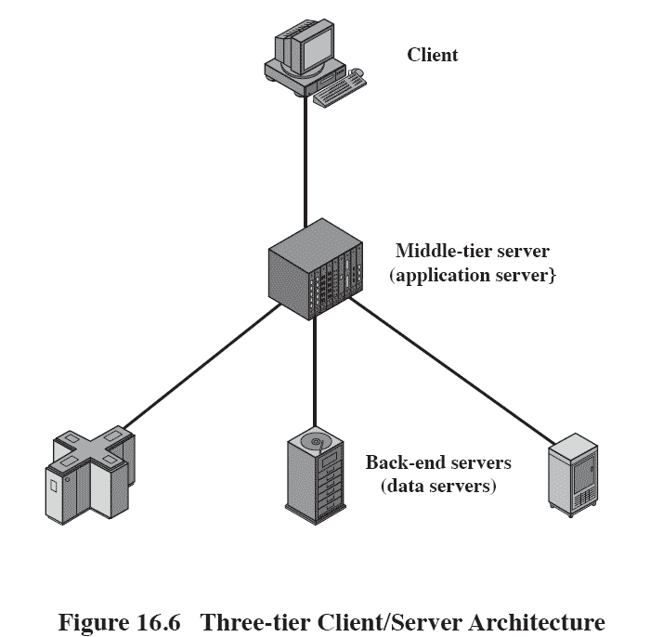
Three-tier Client/Server Architecture

Slide 24
File Cache Consistency
File caches hold recently accessed file records
Caches are consistent when they contain exact copies for remote data
File-locking prevents simultaneous access to a file
Notes:
When a file server is used, performance of file I/O can be noticeably degraded relative to local file access because of the delays imposed by
the network.
To reduce this performance penalty, individual systems can use file caches to hold recently accessed file records.
Because of the principle of locality, use of a local file cache should reduce the number of remote server accesses that must be made.

Slide 25
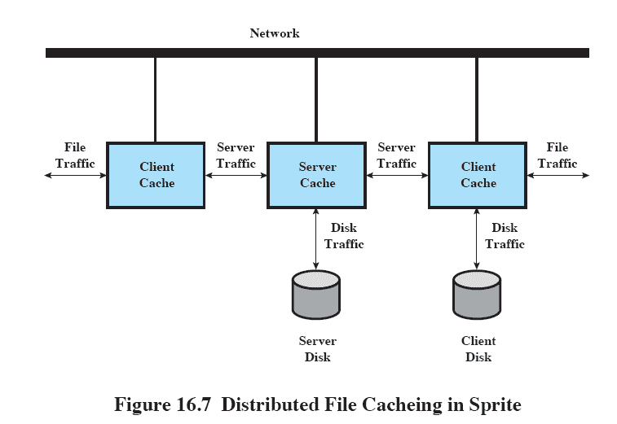
Distributed File Caching in Sprite
Notes:
This figure illustrates a typical distributed mechanism for caching files among a networked collection of workstations.
When a process makes a file access, the request is presented first to the cache of the process’s workstation (“file traffic”).
If not satisfied there, the request is passed either to the local disk, if the file is stored there (“disk traffic”), or to a file server, where the file is stored (“server traffic”).
At the server, the server’s cache is first interrogated and, if there is a miss, then the server’s disk is accessed.
The dual caching approach is used to reduce communications traffic (client cache) and disk I/O (server cache).

Slide 26
Middleware
Set of tools that provide a uniform means and style of access to system resources across all platforms
Enable programmers to build applications that look and feel the same
Enable programmers to use the same method to access data
Notes:
To achieve the true benefits of the client/server approach, developers must have a set of tools that provide a uniform means and style of access to system resources across all platforms.
This will enable programmers to build applications that not only look and feel the same on various PCs and workstations but that use the same
method to access data regardless of the location of that data.

Slide 27
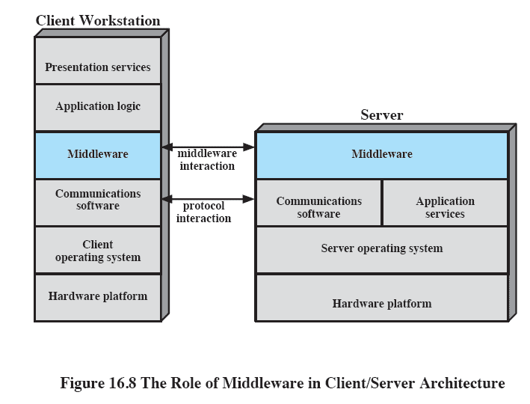
Role of Middleware in Client/Server Architecture
Notes:
This figure suggests the role of middleware in a client/server architecture.
The exact role of the middleware component will depend on the style of client/server computing being used.
Note that there is both a client and server component of middleware.
The basic purpose of middleware is to enable an application or user at a client to access a variety of services on servers without being concerned about differences among servers.

Slide 28
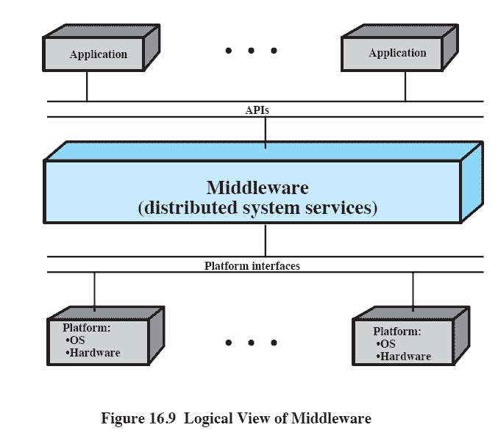
Logical View of Middleware
Notes:
This figure looks at the role of middleware from a logical, rather than an implementation, point of view.
Middle-ware enables the realization of the promise of distributed client/server computing.
The entire distributed system can be viewed as a set of applications and resources available to users.
Users need not be concerned with the location of data or indeed the location of applications.
All applications operate over a uniform applications programming interface (API).
The middleware, which cuts across all client and server platforms, is responsible for routing client requests to the appropriate server.

Slide 29
Roadmap
Distributed Computing Introduction
Client/Server Computing
Distributed message passing
Remote Procedure Calls
Clusters
Windows Cluster Server
Sun Cluster
Beowulf and Linux Clusters

Slide 30
Interprocess Communication (IPC)
Usually computers involved in DDP do not share a main memory
They are isolated computers
IPC techniques relying on filters cannot work
Must rely on message passing
Notes:
Usually, in a distributed processing system, the computers do not share main memory.
Each is an isolated computer system.
Interprocessor communication techniques that rely on shared memory, such as semaphores, cannot be used.
Instead, techniques that rely on message passing are used.

Slide 31
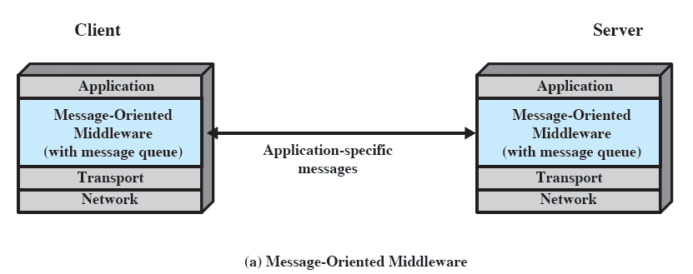
Distributed Message Passing
Notes:
This figure shows the use of message passing to implement client/server functionality.
A client process requires some service (e.g., read a file, print)
It sends a message containing a request for service to a server process.
The server process honours the request and sends a message containing a reply.
In its simplest form, only two functions are needed: Send and Receive.

Slide 32
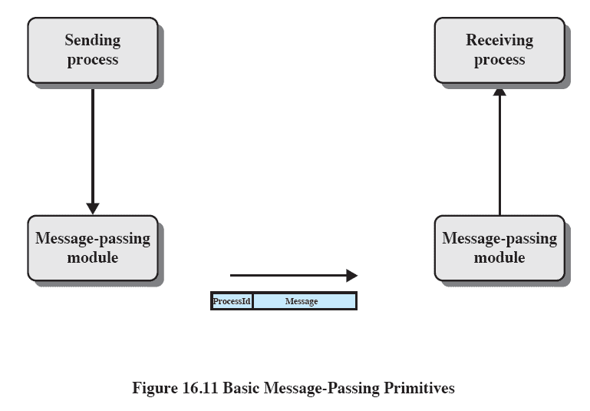
Basic Message-Passing Primitives
Notes:
This figure suggests an implementation for message passing.
Processes make use of the services of a message-passing module.
Service requests can be expressed in terms of primitives and parameters.
A primitive specifies the function to be performed, and the parameters are used to pass data and control information.
The actual form of a primitive depends on the message-passing software.
It may be a procedure call or it may itself be a message to a process that is part of the operating system.

Slide 33
Reliability vs.. Unreliability
Reliable message-passing guarantees delivery if possible
Not necessary to let the sending process know that the message was delivered (but useful)
Send the message out into the communication network without reporting success or failure
Reduces complexity and overhead
Notes:
A reliable message-passing facility is one that guarantees delivery if possible.
Such a facility makes use of a reliable transport protocol or similar logic and performs error checking, acknowledgment, retransmission, and reordering of misordered messages.
Because delivery is guaranteed, it is not necessary to let the sending process know that the message was delivered.
However, it might be useful to provide an acknowledgment back to the sending process so that it knows that delivery has already taken place.
In either case, if the facility fails to achieve delivery, the sending process is notified of the failure.
At the other extreme, the message-passing facility may simply send the message out into the communications network but will report neither success nor failure.
This greatly reduces the complexity and processing and communications overhead of the message-passing facility.
For those applications that require confirmation that a message has been delivered, the applications themselves may use request and reply messages to satisfy the requirement.

Slide 34
Blocking vs.. Nonblocking
Nonblocking
Process is not suspended as a result of issuing a Send or Receive
Efficient and flexible
Difficult to debug
Notes:
With nonblocking, or asynchronous, primitives, a process is not suspended as a result of issuing a Send or Receive.
Thus, when a process issues a Send primitive, the operating system returns control to the process as soon as the message has been queued for transmission or a copy has been made.
If no copy is made, any changes made to the message by the sending process before or even while it is being transmitted are made at the risk of the process.
When the message has been transmitted or copied to a safe place for subsequent transmission, the sending process is interrupted to be in-
formed that the message buffer may be reused.
Similarly, a nonblocking Receive is issued by a process that then proceeds to run.
When a message arrives, the process is informed by interrupt, or it can poll for status periodically.
Nonblocking primitives provide for efficient, flexible use of the message-passing facility by processes.
The disadvantage of this approach is that it is difficult to test and debug programs that use these primitives.
Irreproducible, timing-dependent sequences can create subtle and difficult problems.

Slide 35
Blocking vs.. Nonblocking
Blocking
Send does not return control to the sending process until the message has been transmitted
OR does not return control until an acknowledgment is received
Receive does not return until a message has been placed in the allocated buffer
Notes:
The alternative is to use blocking, or synchronous, primitives.
A blocking Send does not return control to the sending process until the message has been transmitted (unreliable service) or until the message has been sent and an acknowledgment received (reliable service).
A blocking Receive does not return control until a message has been placed in the allocated buffer.

Slide 36
Roadmap
Distributed Computing Introduction
Client/Server Computing
Distributed message passing
Remote Procedure Calls
Clusters
Windows Cluster Server
Sun Cluster
Beowulf and Linux Clusters

Slide 37
Remote Procedure Calls
Allow programs on different machines to interact using simple procedure call/return semantics
Widely accepted
Standardized
Client and server modules can be moved among computers and operating systems easily
Notes:
A variation on the basic message-passing model is the remote procedure call.
This is now a widely accepted and common method for encapsulating communication in a distributed system.
The essence of the technique is to allow programs on different machines to interact using simple procedure call/return semantics, just as if the two programs were on the same machine.
That is, the procedure call is used for access to remote services.
The popularity of this approach is due to the following advantages.
1. The procedure call is a widely accepted, used, and understood abstraction.
2. The use of remote procedure calls enables remote interfaces to be specified as a set of named operations with designated types.
Thus, the interface can be clearly documented and distributed programs can be statically checked
for type errors.
3. Because a standardized and precisely defined interface is specified, the communication code for an application can be generated automatically.
4. Because a standardized and precisely defined interface is specified, developers can write client and server modules that can be moved among computers and operating systems with little modification and recoding.

Slide 38
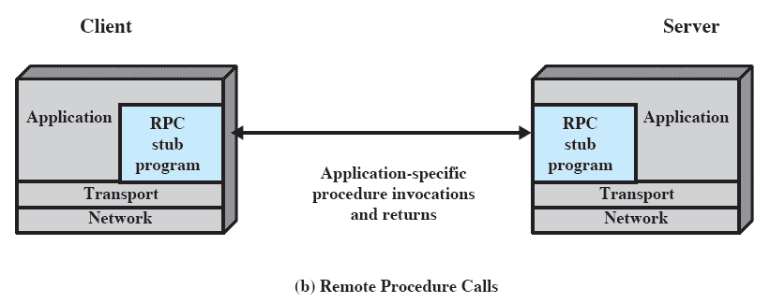
RPC Architecture
Notes:
This figure illustrates the general architecture of a RPC

Slide 39
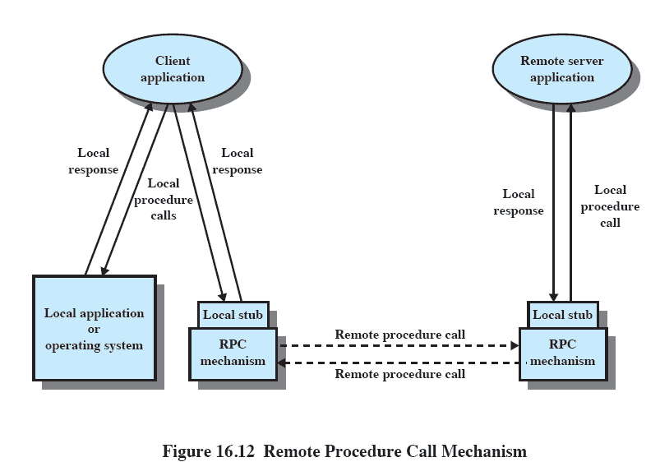
Remote Procedure Call Mechanism
Notes:
A more detailed look at a remote procedure call.
Consider a procedure call:
CALL P(X,Y)
Where:
P = procedure name
X = passed arguments
Y = returned values
It may or may not be transparent to the user that the intention is to invoke a remote procedure on some other machine.
A dummy or stub procedure P must be included in the caller’s address space or be dynamically linked to it at call time.
This procedure creates a message that identifies the procedure being called and includes the parameters.
It then sends this message to a remote system and waits for a reply.
When a reply is received, the stub procedure returns to the calling program, providing the returned values.
At the remote machine, another stub program is associated with the called procedure.
When a message comes in, it is examined and a local CALL P(X, Y) is generated.
This remote procedure is thus called locally, so its normal assumptions about where to find parameters, the state of the stack, and so on are identical to the case of a purely local procedure call.

Slide 40
Parameters
Passing a parameter by value is easy with RPC
Passing by reference is more difficult
A unique system wide pointer is necessary
The representation/format of the parameter and message may be the difficult if the programming languages differ between client and server.
Notes:
Most programming languages allow parameters to be passed as values (call by value)
or as pointers to a location that contains the value (call by reference).
Call by value is simple for a remote procedure call:
the parameters are simply copied into the message and sent to the remote system.
Call by Reverence is more difficult to implement
A unique, system wide pointer is needed for each object.
The overhead for this capability may not be worth the effort.
Another issue is how to represent parameters and results in messages.
If the called and calling programs are in identical programming languages on the same type of machines with the same operating system, then the representation requirement may present no problems.
If there are differences in these areas, then there will probably be differences in the ways in which numbers and even text are represented.
If a full-blown communications architecture is used, then this issue is handled by the presentation layer.
However, the overhead of such an architecture has led to the design of remote procedure call facilities that bypass most of the communications architecture and provide their own basic communications facility.
In that case, the conversion responsibility falls on the remote procedure call facility
The best approach to this problem is to provide a standardized format for common objects, such as integers, floating-point numbers, characters, and character strings.
Then the native parameters on any machine can be converted to and from the standardized representation.

Slide 41
Client/Server Binding
Binding specifies the relationship between remote procedure and calling program
Nonpersistent binding
Logical connection established during remote procedure call
Persistent binding
Connection is sustained after the procedure returns
Notes:
Binding specifies how the relationship between a remote procedure and the calling program will be established.
A binding is formed when two applications have made a logical connection and are prepared to exchange commands and data.
Nonpersistent binding means that a logical connection is established between the two processes at the time of the remote procedure call and that as soon as the values are returned, the connection is dismantled.
Because a connection requires the maintenance of state information on both ends, it consumes resources.
The non-persistent style is used to conserve those resources.
But, the overhead involved in establishing connections makes nonpersistent binding inappropriate for remote procedures that are called frequently by the same caller.
With persistent binding, a connection that is set up for a remote procedure call is sustained after the procedure return.
The connection can then be used for future remote procedure calls.
If a specified period of time passes with no activity on the connection, then the connection is terminated.
For applications that make many repeated calls to remote procedures, persistent binding maintains the logical connection and allows a sequence of calls and returns to use the same connection.

Slide 42
Synchronous versus Asynchronous
Synchronous RPC
Behaves much like a subroutine call
Asynchronous RPC
Does not block the caller
Enable a client execution to proceed locally in parallel with server invocation
Notes:
The concepts of synchronous and asynchronous remote procedure calls are analogous to the concepts of blocking and nonblocking messages.
The traditional remote procedure call is synchronous, which requires that the calling process wait until the called process returns a value.
Thus, the synchronous RPC behaves much like a sub-routine call.
The synchronous RPC is easy to understand and program because its behaviour is predictable.
However, it fails to exploit fully the parallelism inherent in distributed applications.
To provide greater flexibility, various asynchronous RPC facilities have been implemented to achieve a greater degree of parallelism while retaining the familiarity and simplicity of the RPC.
Asynchronous RPCs do not block the caller;
the replies can be received as and when they are needed, thus allowing client execution to proceed locally in parallel with the server invocation.

Slide 43
Object-Oriented Mechanisms
Clients and servers ship messages back and forth between objects
A client sends a request to an object broker
The broker calls the appropriate object and passes along any relevant data
Examples include Microsoft’s COM and CORBA
Notes:
As object-oriented technology becomes more prevalent in operating system design, client/server designers have begun to embrace this approach.
In this approach, clients and servers ship messages back and forth between objects.
Object communications may rely on an underlying message or RPC structure or be developed directly on top of object-oriented capabilities in the operating system.
A client that needs a service sends a request to an object request broker, which acts as a directory of all the remote service available on the network.
The broker calls the appropriate object and passes along any relevant data.
Then the remote object services the request and replies to the broker, which returns the response to the client.

Slide 44
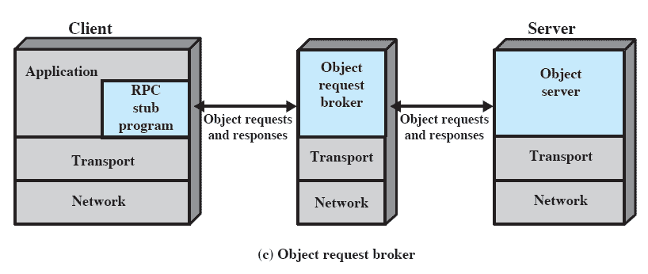
Object Request Broker

Slide 45
Roadmap
Distributed Computing Introduction
Client/Server Computing
Distributed message passing
Remote Procedure Calls
Clusters
Windows Cluster Server
Sun Cluster
Beowulf and Linux Clusters

Slide 46
Clusters
Alternative to symmetric multiprocessing (SMP)
Group of interconnected, whole computers working together as a unified computing resource
Illusion is one machine
System can run on its own
Notes:
Clustering is an alternative to symmetric multiprocessing (SMP) as an approach to providing high performance and high availability and is particularly attractive for server applications.
A cluster as a group of interconnected, whole computers working together as a unified computing resource that can create the
illusion of being one machine.
The term whole computer means a system that can run on its own, apart from the cluster;
Each computer in a cluster is typically referred to as a node.

Slide 47
Benefits of Clusters
Absolute Scalability
Larger than any single device is possible
Incremental scalability
System can grow by adding new nodes
High availability
Failure of one node is not critical to system
Superior price/performance
Using commodity equipment
Notes:
Absolute scalability:
It is possible to create large clusters that far surpass the power of even the largest standalone machines.
A cluster can have dozens or even hundreds of machines, each of which is a multiprocessor.
Incremental scalability:
A cluster is configured in such a way that it is possible to add new systems to the cluster in small increments.
Thus, a user can start out with a modest system and expand it as needs grow, without having to go through a major upgrade in which an existing small system is replaced with a larger system.
High availability:
Because each node in a cluster is a standalone computer, the failure of one node does not mean loss of service.
In many products, fault tolerance is handled automatically in software.
Superior price/performance:
By using commodity building blocks, it is possible to put together a cluster with equal or greater computing power than a single large machine, at much lower cost.

Slide 48
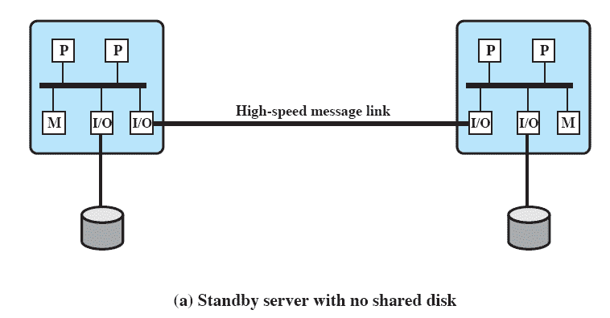
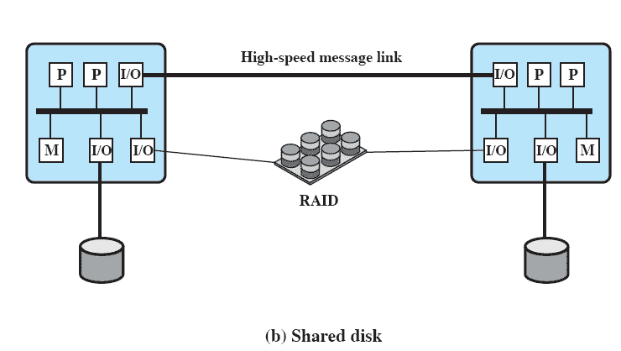
Cluster Classification
Numerous approaches to classification.
Simplest is based on shared disk access
Notes:
Clusters are classified in a number of different ways.
Perhaps the simplest classification is based on whether the computers in a cluster share access to the same disks.
Figure “a” shows a two-node cluster in which the only interconnection is by means of a high-speed link that can be used for message exchange
to coordinate cluster activity.
The link can be a LAN that is shared with other computers that are not part of the cluster
or the link can be a dedicated interconnection facility.
In the latter case, one or more of the computers in the cluster will have a link to a LAN or WAN so that there is a connection between the server cluster and remote client systems.
Note that in the figure, each computer is depicted as being a multiprocessor.
This is not necessary but does enhance both performance and availability.
Figure – “b” shows the other alternative – a shared-disk cluster.
In this case, there generally is still a message link between nodes.
Also there is a disk subsystem that is directly linked to multiple computers within the cluster.
In Figure “b”, the common disk subsystem is a RAID system.
The use of RAID or some similar redundant disk technology is common in clusters so that the high availability achieved by the presence of multiple computers is not compromised by a shared disk that is a single point of failure.

Slide 49
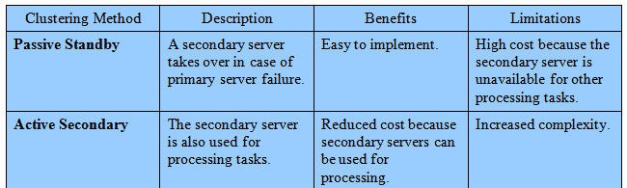
Clustering Methods: Benefits and Limitations

Slide 50
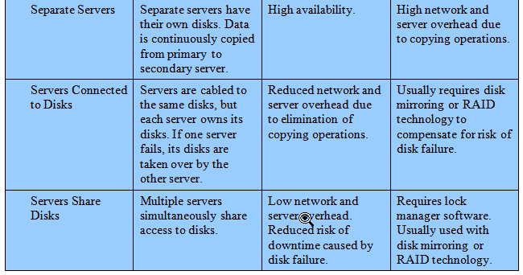
Clustering Methods: Benefits and Limitations

Slide 51
Operating System Design Issues
Clusters require some enhancements to a single-system OS.
Failure Management
Load Balancing
Parallelizing Computation
Notes:
Full exploitation of a cluster hardware configuration requires some enhancements to a single-system operating system.

Slide 52
Failure Management
Highly available cluster offers a high probability that all resources will be in service
No guarantee about the state of partially executed transactions if failure occurs
Fault-tolerant cluster ensures that all resources are always available
Failover vs. FailBack
Notes:
How failures are managed by a cluster depends on the clustering method used.
Two approaches can be taken to dealing with failures:
highly available clusters and
fault-tolerant clusters.
A highly available cluster offers a high probability that all resources will be in service.
If a failure occurs, such as a node goes down or a disk volume is lost, then the queries in progress are lost.
Any lost query, if retried, will be serviced by a different computer in the cluster.
However, the cluster operating system makes no guarantee about the state of partially executed transactions.
This would need to be handled at the application level.
A fault-tolerant cluster ensures that all resources are always available.
This is achieved by the use of redundant shared disks and mechanisms for backing out uncommitted transactions and committing completed transactions.
Failover The function of switching an application and data resources over from a failed system to an alternative system in the cluster is referred to as failover.
FailBack A related function is the restoration of applications and data resources to the original system once it has been fixed;
this is referred to as failback.
Failback can be automated, but this is desirable only if the problem is truly fixed and unlikely to recur.
If not, automatic failback can cause subsequently failed resources to bounce back and forth between computers, resulting in performance and recovery problems.

Slide 53
Load Balancing
When new computer added to the cluster, the load-balancing facility should automatically include this computer in scheduling applications
Middleware must recognize that services can appear on many different members of the cluster
Notes:
A cluster requires an effective capability for balancing the load among available computers.
This includes the requirement that the cluster be incrementally scalable.
When a new computer is added to the cluster, the load-balancing facility should automatically include this computer in scheduling applications.
Middleware mechanisms need to recognize that services can appear on different members of the cluster and may migrate from one member to another.

Slide 54
Parallelizing Computation
Parallelizing compiler
determines, at compile time, which parts of an application can be executed in parallel.
Parallelized application
application written to run on a cluster and uses message passing to move data,
Parametric computing
Algorithm must run many times with different parameters
Notes:
In some cases, effective use of a cluster requires executing software from a single application in parallel.
Three general approaches to the problem:
Parallelizing compiler:
A parallelizing compiler determines, at compile time, which parts of an application can be executed in parallel.
These are then split off to be assigned to different computers in the cluster.
Performance depends on the nature of the problem and how well the compiler is designed.
Parallelized application:
The programmer writes the application from the outset to run on a cluster and uses message passing to move data, as required, between cluster nodes.
This places a high burden on the programmer but may be the best approach for exploiting clusters for some applications.
Parametric computing:
This approach can be used if the essence of the application is an algorithm or program that must be executed a large number of times, each time with a different set of starting conditions or parameters.

Slide 55
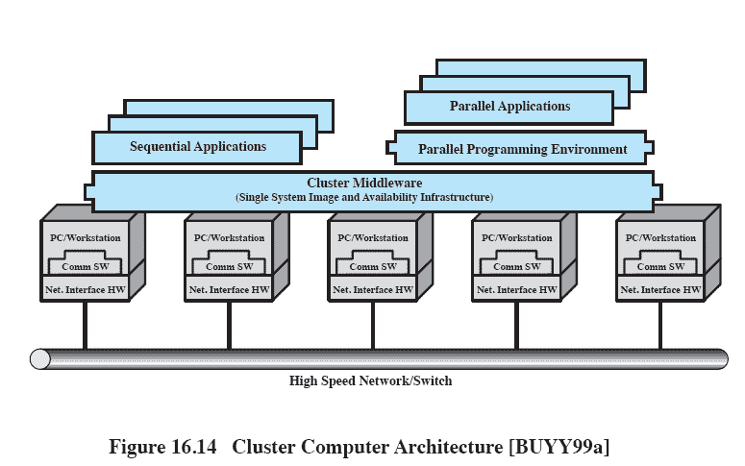
Cluster Computer Architecture
Notes:
The individual computers are connected by some high-speed LAN or switch hardware.
Each computer is capable of operating independently.
A middleware layer of software is installed in each computer to enable cluster operation.
The cluster middleware provides a unified system image to the user, known as a single-system image.
The middleware may also be responsible for providing high availability, by means of load balancing and responding to failures in individual components.

Slide 56
Middleware Services and Functions
Single entry point
User logs onto cluster, not individual server
Single file hierarchy
Single control point
Single virtual networking
Single memory space
Distributed shared memory enables programs to share variables.
Notes:
Single entry point: A user logs onto the cluster rather than to an individual computer.
Single file hierarchy: The user sees a single hierarchy of file directories under the same root directory.
Single control point: There is a default node used for cluster management and control.
Single virtual networking: Any node can access any other point in the cluster, even though the actual cluster configuration may consist of multiple inter-connected networks.
There is a single virtual network operation.
Single memory space: Distributed shared memory enables programs to share variables.

Slide 57
Middleware Services and Functions (cont.)
Single job-management system
Single user interface
Single I/O space
Single process space
Checkpointing
Allowing rollback and recovery
Process migration
Enables load balancing
Notes:
Single job-management system: Under a cluster job scheduler, a user can submit a job without specifying the host computer to execute the job.
Single user interface: A common graphic interface supports all users, regardless of the workstation from which they enter the cluster.
Single I/O space: Any node can remotely access any I/O peripheral or disk device without knowledge of its physical location.
Single process space: A uniform process-identification scheme is used.
A process on any node can create or communicate with any other process on a remote node.
Checkpointing: This function periodically saves the process state and intermediate computing results, to allow rollback recovery after a failure.
Process migration: This function enables load balancing.

Slide 58
Clusters Compared to SMP
SMP is easier to manage and configure, take up less space and draw less power
SMP products are well established and stable
Clusters are better for incremental and absolute scalability
Clusters are superior in terms of availability
Notes:
Both clusters and symmetric multiprocessors provide a configuration with multiple processors to support high-demand applications.
Both solutions are commercially available, although SMP has been around far longer.
The main strength of the SMP approach is that an SMP is easier to manage and configure than a cluster.
The SMP is much closer to the original single-processor model for which nearly all applications are written.
The principal change required in going from a uniprocessor to an SMP is to the scheduler function.
Another benefit of the SMP is that it usually takes up less physical space and draws less power than a comparable cluster.
A final important benefit is that the SMP products are well established and stable.
Clusters are far superior to SMPs in terms of incremental and absolute scalability.
Clusters are also superior in terms of availability, because all components of the system can readily be made highly redundant.

Slide 59
Roadmap
Distributed Computing Introduction
Client/Server Computing
Distributed message passing
Remote Procedure Calls
Clusters
Windows Cluster Server
Sun Cluster
Beowulf and Linux Clusters

Slide 60
Windows Cluster Server
A ‘shared nothing’ cluster
Resources owned by single systems at a time
Notes:
Windows Cluster Server is a shared-nothing cluster, in which each disk volume and other resources are owned by a single system at
a time.

Slide 61
Windows Cluster Server
Cluster Service
Manages cluster activity
Resource
Item managed by the cluster
Online
Resource is online when providing a service
Group
Set of elements needed to run an application
Notes:
The Windows Cluster Server design makes use of the following concepts:
Cluster Service: The collection of software on each node that manages all cluster-specific activity.
Resource: An item managed by the cluster service.
All resources are objects representing actual resources in the system, including hardware devices such as disk drives and network cards and logical items such as logical disk volumes, TCP/IP addresses, entire applications, and databases.
Online: A resource is said to be online at a node when it is providing service on that specific node.
Group: A collection of resources managed as a single unit.
Usually, a group contains all of the elements needed to run a specific application and for client systems to connect to the service provided by that application.

Slide 62
Group
Combines resources into larger units that are easily managed
Operations performed on a group affect all resources in that group.
Resources are implemented as DLL’s
Managed by resource monitor
Resource Monitor uses RPC to interact with Cluster Service.
Notes:
The concept of group is of particular importance.
A group combines resources into larger units that are easily managed,
both for failover and load balancing.
Operations performed on a group, such as transferring the group to another node, automatically affect all of the resources in that group.
Resources are implemented as dynamically linked libraries (DLLs) and managed by a resource monitor.
The resource monitor interacts with the cluster service via remote procedure calls and responds to cluster service commands to configure and move resource groups.

Slide 63
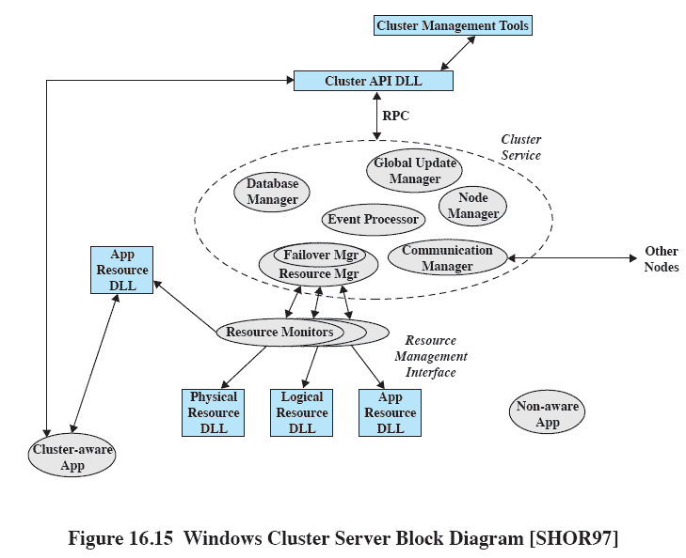
Windows Cluster Server Block Diagram
Notes:
This figure depicts the Windows Cluster Server components and their relationships in a single system of a cluster.
The node manager is responsible for maintaining this node’s membership in the cluster.
Periodically, it sends heartbeat messages to the node managers on other nodes in the cluster.
If one node manager detects a loss of heartbeat messages from another cluster node,
it broadcasts a message to the entire cluster, causing all members to exchange messages to verify their view of current cluster membership.
If a node manager does not respond,
it is removed from the cluster and its active groups are transferred to one or more other active nodes in the cluster.

Slide 64
Major Components
Configuration database manager
Manages the database with information about resources, groups and node ownership of groups
Resource Manager/Failover Manager
makes all decisions regarding resource groups and initiates appropriate actions
Event processor
Connects components
Notes:
The configuration database manager maintains the cluster configuration database.
The database contains information about resources and groups and node ownership of groups.
The database managers on each of the cluster nodes cooperate to maintain a consistent picture of configuration information.
Fault-tolerant transaction software is used to assure that changes in the overall cluster configuration are performed consistently and correctly.
The resource manager/failover manager makes all decisions regarding resource groups and initiates appropriate actions such as startup, reset, and failover.
When failover is required, the failover managers on the active node cooperate to negotiate a distribution of resource groups from the failed system to the remaining active systems.
When a system restarts after a failure, the failover manager can decide to move some groups back to this system.
In particular, any group may be configured with a preferred owner. If that owner fails and then restarts, the group is moved back to the node in a rollback operation.
The event processor connects all of the components of the cluster service, handles common operations, and controls cluster service initialization.
The communications manager manages message exchange with all other nodes of the cluster.
The global update manager provides a service used by other components within the cluster service.

Slide 65
Roadmap
Distributed Computing Introduction
Client/Server Computing
Distributed message passing
Remote Procedure Calls
Clusters
Windows Cluster Server
Sun Cluster
Beowulf and Linux Clusters

Slide 66
Sun Cluster
Distributed OS built as a set of extensions to Solaris UNIX system
Provides a cluster with a single-system image
The cluster is transparent to the user who sees a single computer system running Solaris
Notes:
Sun Cluster is a distributed operating system built as a set of extensions to the base Solaris UNIX system.
It provides cluster with a single-system image;
that is, the cluster appears to the user and applications as a single computer running the Solaris operating system.

Slide 67
Major Components
Major components
Object and communication support
Process management
Networking
Global distributed file system

Slide 68
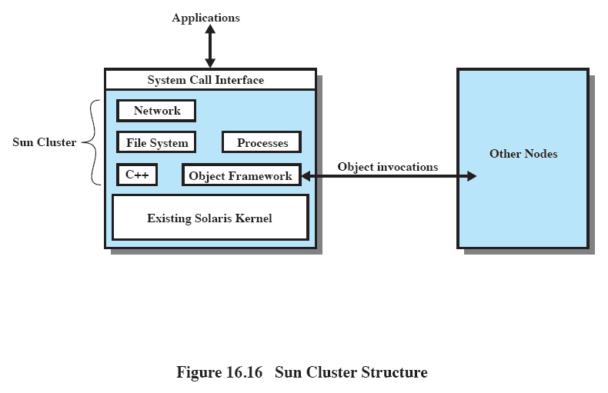
Sun Cluster Structure
Notes:
Discussion follows

Slide 69
Object and Communication Support
Sun Cluster is object orientated
CORBA object model defines used to define objects and RPC mechanism
CORBA Interface Definition Language specifies interfaces between components in different nodes
Uses Solaris kernel with virtually no changes.
Notes:
The Sun Cluster implementation is object oriented.
The CORBA object model is used to define objects and the remote procedure call (RPC) mechanism implemented in Sun Cluster.
The CORBA Interface Definition Language (IDL) is used to specify interfaces between MC components in different nodes.
The elements of MC are implemented in the object-oriented language C++.
The use of a uniform object model and IDL provides a mechanism for internode and intranode interprocess communication.
All of this is built on top of the Solaris kernel with virtually no changes required to the kernel.

Slide 70
Process Management
Process management extends globally
The location of a process is transparent to a user
Process ID’s are unique across the cluster
Each node can learn location and status of each process
Process migration is possible
But all threads of a process must be on the same node
Notes:
Global process management extends process operations so that the location of a process is transparent to the user.
Sun Cluster maintains a global view of processes so that there is a unique identifier for each process in the cluster and so that each node can learn the location and status of each process.
Process migration is possible:
A process can move from one node to another during its lifetime, to achieve load balancing or for failover.
However, the threads of a single process must be on the same node.

Slide 71
Networking
Uses a packet filter to rout packets to the proper node
Externally, the cluster appears as a single server with a single IP address.
Incoming connections (client requests) are load balanced among the available nodes of the cluster.
Notes:
Use a packet filter to route packets to the proper node and perform protocol processing on that node.
Externally, the cluster appears as a single server with a single IP address.
Incoming connections (client requests) are load balanced among the available nodes of the cluster.
The Sun Cluster networking subsystem has three key elements:
Incoming packets are first received on the node that has the network adapter physically attached to it;
The receiving node filters the packet and delivers it to the correct target node over the cluster interconnect.
2. All outgoing packets are routed over the cluster interconnect to the node (or one of multiple alternative nodes) that has an external network physical connection.
All protocol processing for outgoing packets is done by the originating node.
3. A global network configuration database is maintained to keep track of network traffic to each node.

Slide 72
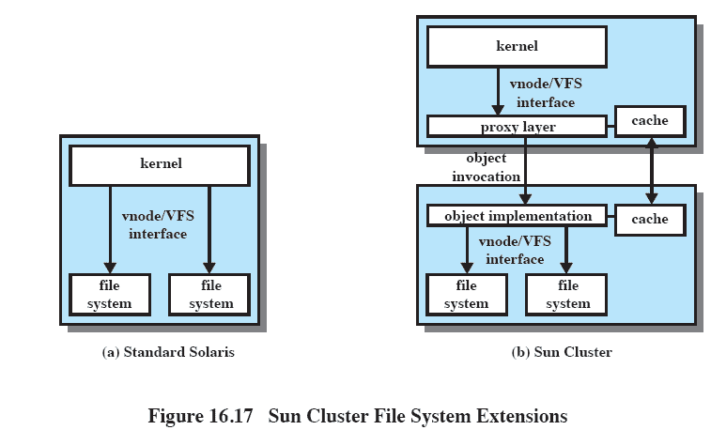
Sun Cluster File System Extensions
Notes:
The most important element of Sun Cluster is the global file system, depicted here, which contrasts MC file management with the basic Solaris scheme.
Both are built on the use of vnode and virtual file system concepts.
In Sun Cluster, the global file system provides a uniform interface to files distributed over the cluster.
A process can open a file located anywhere in the cluster, and processes on all nodes use the same pathname to locate a file.
To implement global file access, MC includes a proxy file system built on top of the existing Solaris file system at the vnode interface.
The vfs/vnode operations are converted by a proxy layer into object invocations (see Figure 16.17b).
The invoked object may reside on any node in the system.
The invoked object performs a local vnode/vfs operation on the underlying file system.
Neither the kernel nor the existing file systems have to be modified to support this global file environment.
To reduce the number of remote object invocations, caching is used.
Sun Cluster supports caching of file contents, directory information, and file attributes.

Slide 73
Roadmap
Distributed Computing Introduction
Client/Server Computing
Distributed message passing
Remote Procedure Calls
Clusters
Windows Cluster Server
Sun Cluster
Beowulf and Linux Clusters

Slide 74
Beowulf and Linux Clusters
Initiated in 1994 by NASA’s High Performance Computing and Communications project
To investigate the potential for clustered PC’s to perform computational tasks beyond the capacity of typical workstations at minimal cost
The project was a success!
Notes:
In 1994, the Beowulf project was initiated under the sponsorship of the NASA High Performance Computing and Communications (HPCC) project.
Its goal was to investigate the potential of clustered PCs for performing important computation tasks beyond the capabilities of contemporary workstations at minimum cost.
Today, the Beowulf approach is widely implemented and is perhaps the most important cluster technology available.

Slide 75
Beowulf and Linux Clusters
Key features
Mass market commodity components
Dedicated processors (rather than scavenging cycles from idle workstations)
A dedicated, private network (LAN or WAN or internetted combination)
No custom components
Easy replication from multiple vendors

Slide 76
Beowulf Features
Mass market commodity items
Dedicated processors and network
Scalable I/O
A freely available software base
Use freely available distribution computing tools with minimal changes
Return of the design and improvements to the community
Notes:
Although elements of Beowulf software have been implemented on a number of different platforms, the most obvious choice for a base is Linux, and most Beowulf implementations use a cluster of Linux workstations and/or PCs.

Slide 77
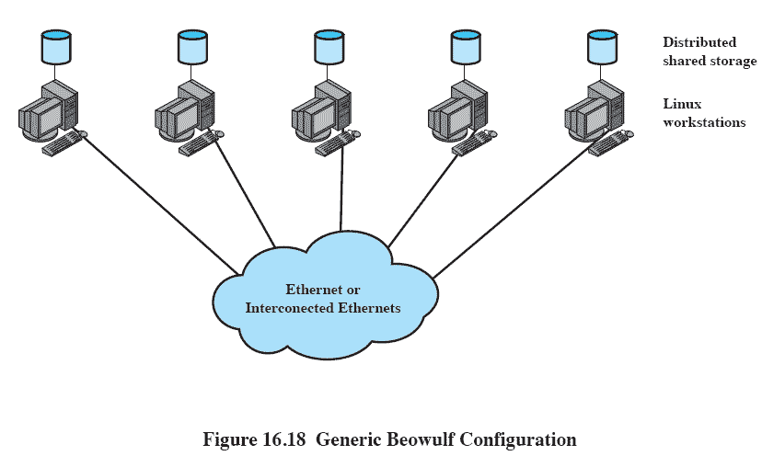
Generic Beowulf Configuration
Notes:
This figure depicts a representative configuration.
The cluster consists of a number of work-stations, perhaps of differing hardware platforms, all running the Linux operating system.
Secondary storage at each workstation may be made available for distributed access (for distributed file sharing, distributed virtual memory, or other uses).
The cluster nodes (the Linux systems) are interconnected with a commodity networking approach, typically Ethernet.
The Ethernet support may be in the form of a single Ethernet switch or an interconnected set of switches.
Commodity Ethernet products at the standard data rates (10 Mbps, 100 Mbps, 1 Gbps) are used.

Slide 78
Beowulf Software
Each node runs it’s own copy of the Linux Kernel and functions as an autonomous system
Extensions to the kernel allow nodes to participate in a number of global namespaces
Notes:
Each node in the Beowulf cluster runs its own copy of the Linux kernel and can function as an autonomous Linux system.
To support the Beowulf cluster concept, extensions are made to the Linux kernel to allow the individual nodes to participate in a number of global namespaces.

Slide 79
System Software
Beowulf distributed process space (BPROC)
Allows process ID to span multiple nodes
Beowulf Ethernet Channel Bonding
Pvmsync
Synchronises shared objects
EnFuzion
set of tools for doing parametric computing.
Notes:
The following are examples of Beowulf system software:
Beowulf distributed process space (BPROC):
This package allows a process ID space to span multiple nodes in a cluster environment and also provides mechanisms for starting processes on other nodes.
Provides key elements needed for a single system image on Beowulf cluster.
Provides a mechanism to start processes on remote nodes without ever logging into another node and by making all the remote processes visible in the process table of the cluster’s front-end node.
Beowulf Ethernet Channel Bonding:
This is a mechanism that joins multiple low-cost networks into a single logical network with higher bandwidth.
The only additional work over using single network interface is the computationally simple task of distributing the packets over the available device transmit queues.
This approach allows load balancing over multiple Ethernets connected to Linux workstations.
Pvmsync:
This is a programming environment that provides synchronization mechanisms and shared data objects for processes in a Beowulf cluster.
EnFuzion:
EnFuzion consists of a set of tools for doing parametric computing.
Parametric computing involves the execution of a program as a large number of jobs, each with different parameters or starting conditions.
EnFusion emulates a set of robot users on a single root node machine, each of which will log into one of the many clients that form a cluster.
Each job is set up to run with a unique, programmed scenario, with an appropriate set of starting conditions

